Slide 1
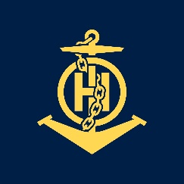
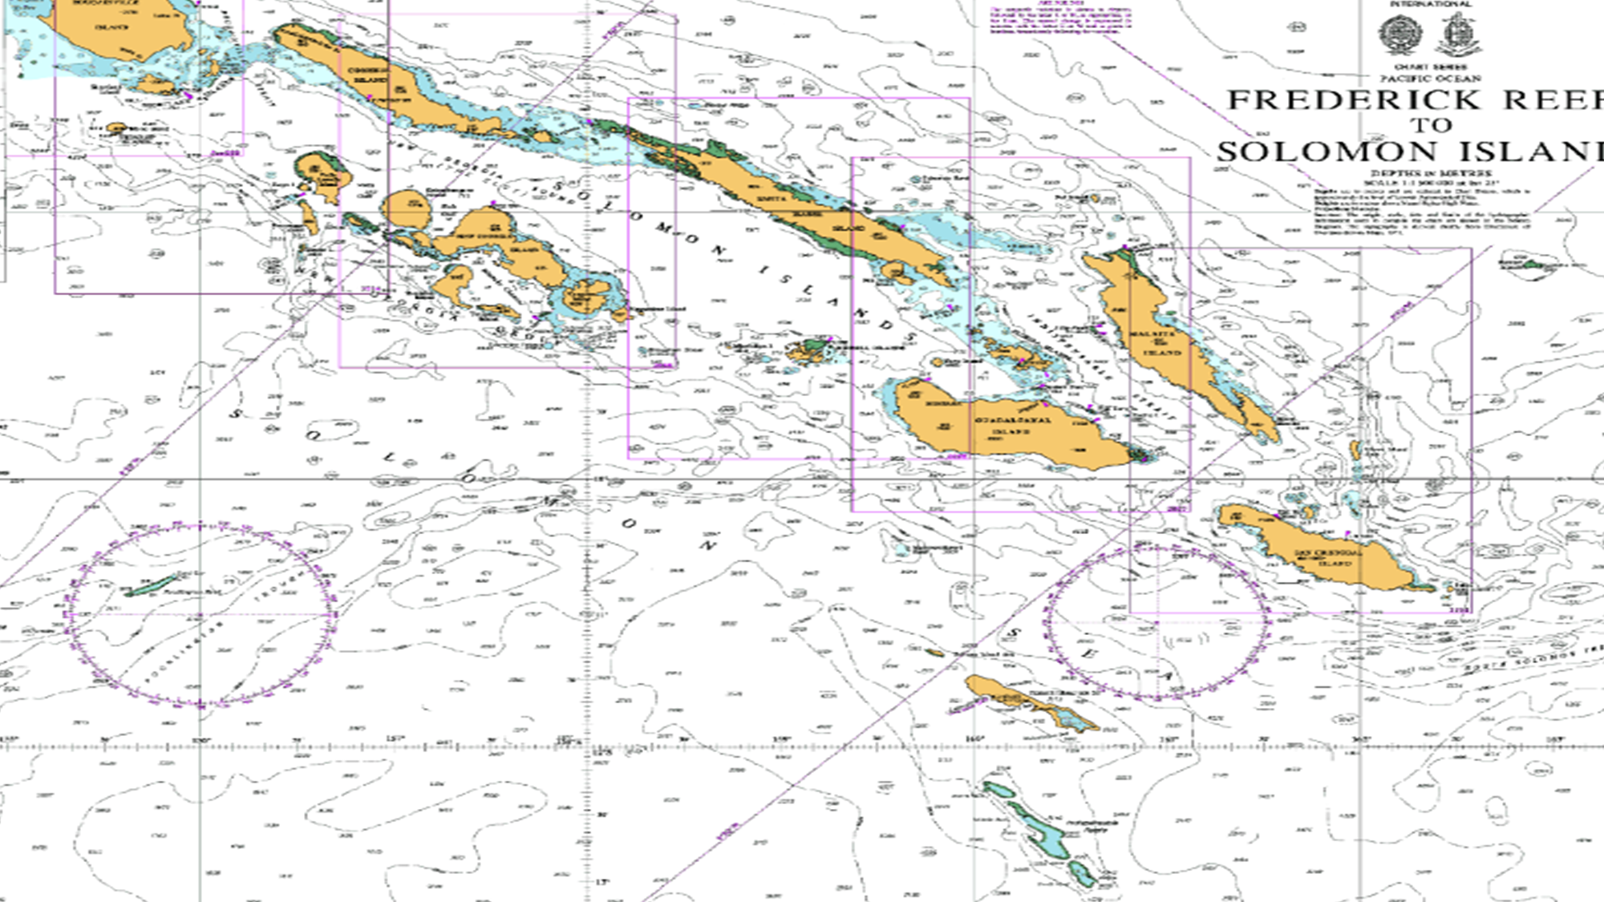
Brief Presentation – IHO – NIPPON FOUNDATION 2019 ALUMNI SEMINAR 29 – 31 October, Singapore
IHO – NIPPON FOUNDATION
ALUMNI SEMINAR
John Dalomae

Slide 2
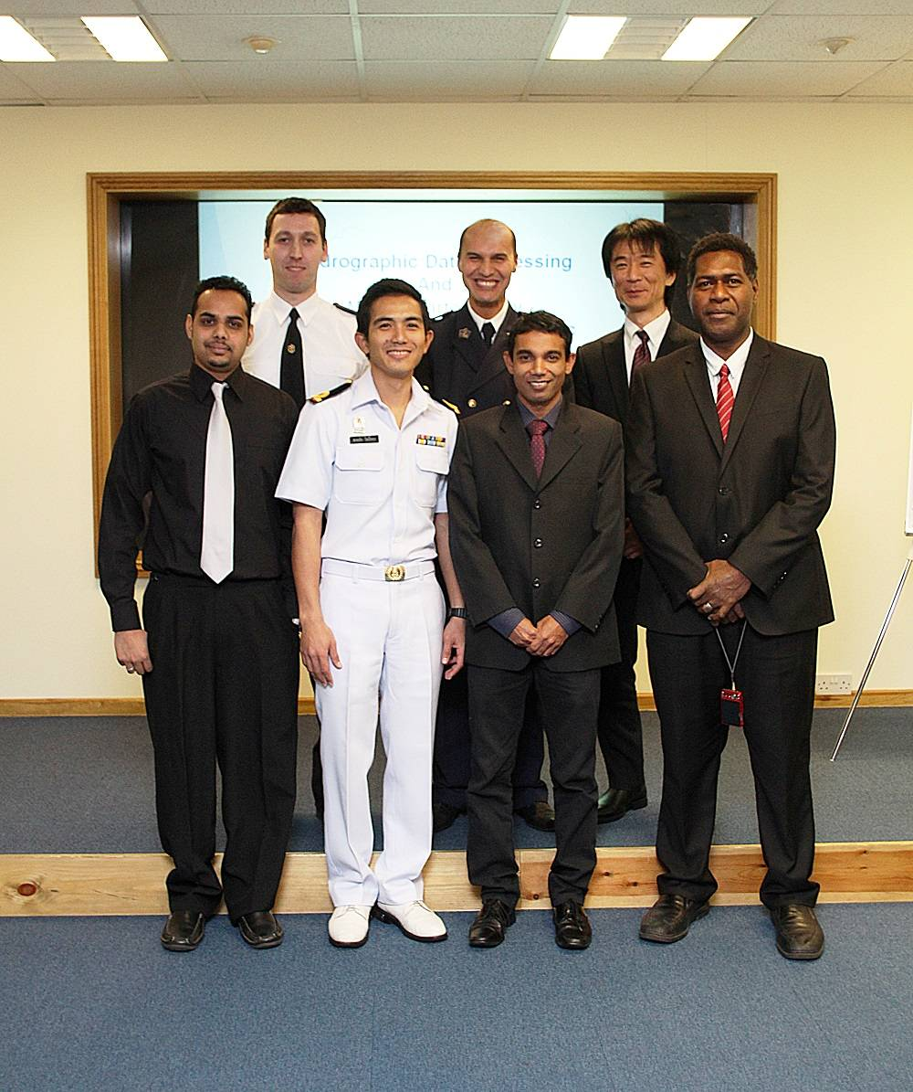
Self introduction
IHO – NIPPON FOUNDATION
ALUMNI SEMINAR
Name | JOHN DALOMAE
Alumni year | 2013
Country | SOLOMON ISLANDS
Organization | SOLOMON ISLANDS HYDROGRAPHIC UNIT, S.I. MARITIME SAFETY ADMINISTRATION (SIMSA)
Position/Job title | PRINCIPAL NAUTICAL CARTOGRAPHER
Current job description | Assist the Australian Hydrographic Office (AHO) Chart Branch with Charting issues in Solomon Islands, Assist AtoN Units, Accompany Hydrographic Surveyors when surveys are undertaken,
CAT B CLASS OF 2013

Slide 3
My career path and projects / Achievements
IHO – NIPPON FOUNDATION
ALUMNI SEMINAR
Senior Nautical Cartographer Principal Nautical Cartographer
Aids To Navigation Manager
Projects – Publication of National Chart Series (BA, Aus to SLB Codes)
- Publication of SI National Tide Tables
- Continuous Surveying of anchorages for cruise ships and
domestic routes – Updating of charts
Significant achievement: SI became IHO’s 91st Member State
15 July 2019

Slide 4
Lessons learned from CHART Course
IHO – NIPPON FOUNDATION
ALUMNI SEMINAR
During the Course
– Meeting other Course Participants in 2013
- Meeting the Course Trainers & other UKHO Staff
- The Importance of Hydrographic Services – Nautical Charting
After the Training
– Organisation’s Charting Capabilities
- The need to introduce Hydrographic Services to the
Government, Maritime Stakeholders, Related Agencies

Slide 5
IHO – NIPPON FOUNDATION
ALUMNI SEMINAR
MITIGATING MEASURES:
28 September 2017 – SIMSA Signs a “Memorandum of Understanding” (MoU) with Australian Hydrographic
Office (AHO) concerning CO-OPERATION IN THE FIELD OF HYDROGRAPHY, and became
Solomon Islands’ “Primary Charting Authority (PCA).
- PCA – Publish National Chart Series & Nautical Publications
- Carry-out hydrographic surveys from depth of 200m+
- Do Validation QC and QA on submitted surveys
- Coordinate Surveying and Cartographic Trainings
Current – On going trainings on Hydrographic Surveying with Equipment suppliers
- Awareness programs on the Importance of Hydrographic Services

Slide 6
Suggestion for the future
IHO – NIPPON FOUNDATION
ALUMNI SEMINAR
Small Hydrographic Office:
- Propose Cartographic trainings or Exchange of personnel
- Request visits by PCA specialised officers – Hydrographic &
Cartographic
Information Sharing between IHO, Regional Hydrographic Commissions and bigger Hydrographic Offices/ Organisations on Charting Issues etc,
More Cooperation in the field of Charting Projects…Technology

Slide 7
Thank you all for listening……

